Slide 1

INTRODUCTION TO
Machine Learning
Lecture Slides for
ETHEM ALPAYDIN
© The MIT Press, 2004
alpaydin@boun.edu.tr
http://www.cmpe.boun.edu.tr/~ethem/i2ml

Slide 2
Outline
Discriminant Function
Learning Association Rules
Naïve Bayes Classifier
Example: Play Tennis
Relevant Issues
Conclusions

Slide 3

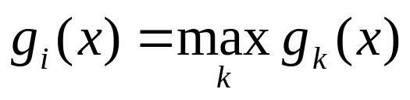
What is discriminant Function
For classification problem, for each class, define a function such that we choose Ci if
Lecture Notes for E Alpaydın 2004 Introduction to Machine Learning © The MIT Press (V1.1)

Slide 4


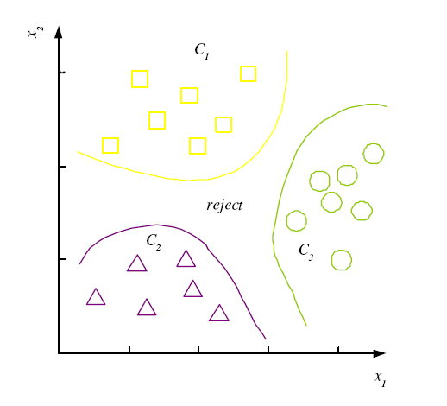
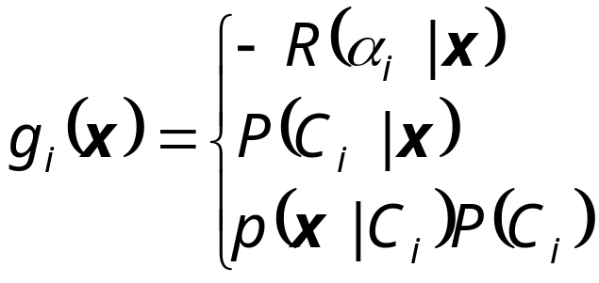

Discriminant Functions
K decision regions R₁,...,R_{K}
Lecture Notes for E Alpaydın 2004 Introduction to Machine Learning © The MIT Press (V1.1)

Slide 5
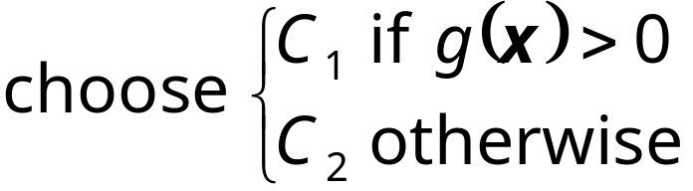
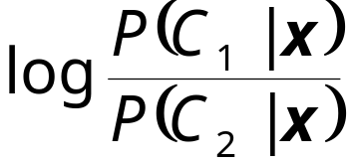
K=2 Classes
Dichotomizer (K=2) vs Polychotomizer (K>2)
g(x) = g₁(x) – g₂(x)
Log odds:
Lecture Notes for E Alpaydın 2004 Introduction to Machine Learning © The MIT Press (V1.1)

Slide 6
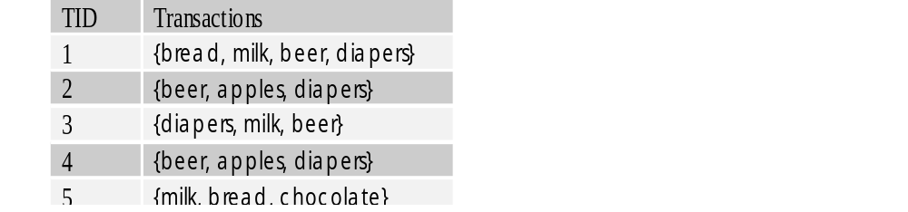
Problem: Association Rule Mining
INPUT
A set of transactions
Objective:
Given a set of transactions D, generate all association rules that have support and confidence greater than the user-specified minimum support and minimum confidence.
Minimize computation time by pruning.
Constraints:
Items should be in lexicographical order
Association Rules
{Diaper} → {Beer},
{Milk, Bread} → {Eggs, Coke},
{Beer, Bread} → {Milk},
Real World Applications
NCR (Terradata) does ARM for more than 20 large retail organizations including Walmart.
Used for pattern discovery in biological DBs.

Slide 7
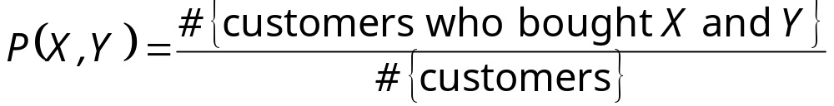
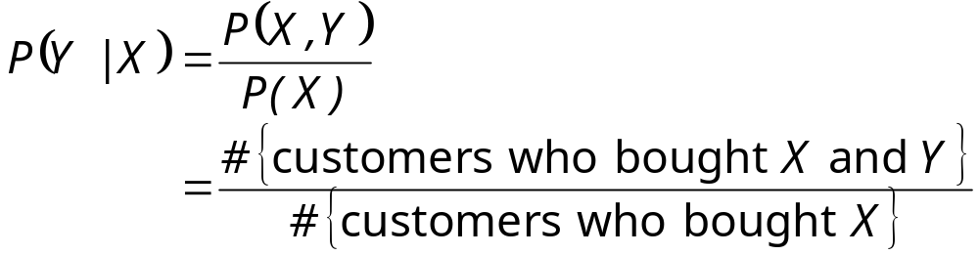
Association Rules
Association rule: X → Y
Support (X → Y):
Confidence (X → Y):
Apriori algorithm (Agrawal et al., 1996)
Lecture Notes for E Alpaydın 2004 Introduction to Machine Learning © The MIT Press (V1.1)

Slide 8
Apriori Algorithm:
Breadth First Search
{ }
a
b
c
d
a b
a d
b d
a b d
ICDM'06 Panel

Slide 9
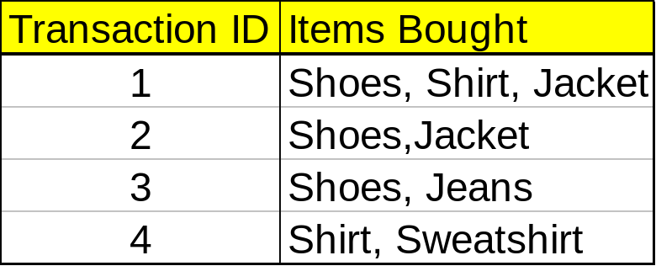
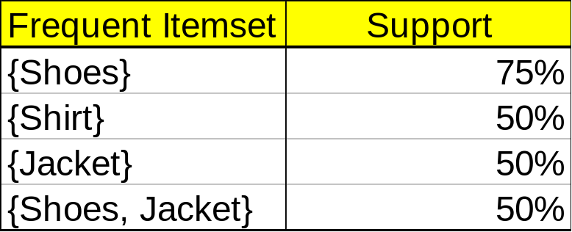
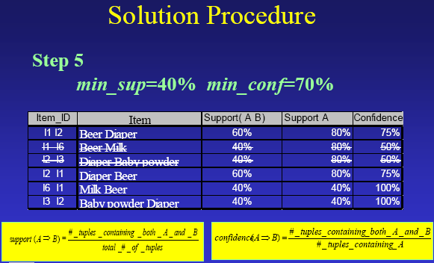
Apriori Algorithm Examples
Problem Decomposition
If the minimum support is 50%, then {Shoes, Jacket} is the only 2- itemset that satisfies the minimum support.
If the minimum confidence is 50%, then the only two rules generated from this 2-itemset, that have confidence greater than 50%, are:
Shoes ⇒ Jacket Support=50%, Confidence=66%
Jacket ⇒ Shoes Support=50%, Confidence=100%

Slide 10








The Apriori Algorithm — Example
Min support =50%
Database D
L₁
C₁
Scan D
C₂
C₂
L₂
Scan D
C₃
Scan D
L₃

Slide 11
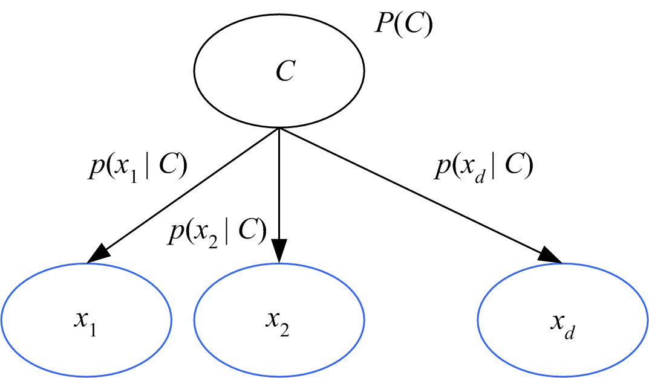
Naive Bayes’ Classifier
Given C, x_{j} are independent:
p(x|C) = p(x₁|C) p(x₂|C) ... p(x_{d}|C)
Lecture Notes for E Alpaydın 2004 Introduction to Machine Learning © The MIT Press (V1.1)

Slide 12
Background
There are three methods to establish a classifier
a) Model a classification rule directly
  Examples: k-NN, decision trees, perceptron, SVM
  b) Model the probability of class memberships given input data
  Example: multi-layered perceptron with the cross-entropy cost
c) Make a probabilistic model of data within each class
  Examples: naive Bayes, model based classifiers
a) and b) are examples of discriminative classification
c) is an example of generative classification
b) and c) are both examples of probabilistic classification

Slide 13



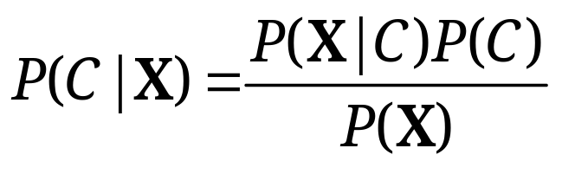
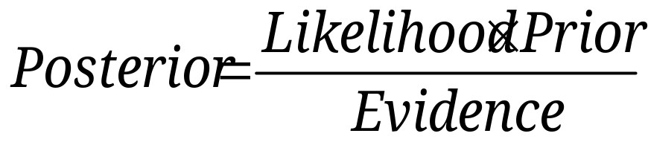
Probability Basics
Prior, conditional and joint probability
  Prior probability:
  Conditional probability:
  Joint probability:
  Relationship:
  Independence:
Bayesian Rule

Slide 14

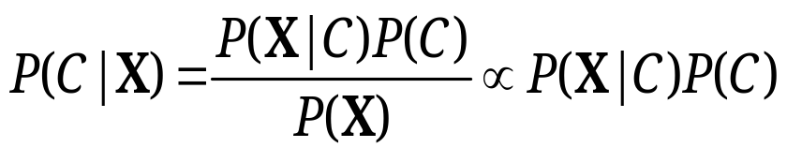
Probabilistic Classification
Establishing a probabilistic model for classification
  Discriminative model
  Generative model
MAP classification rule
  MAP: Maximum A Posterior
  Assign x to c* if
Generative classification with the MAP rule
  Apply Bayesian rule to convert:

Slide 15

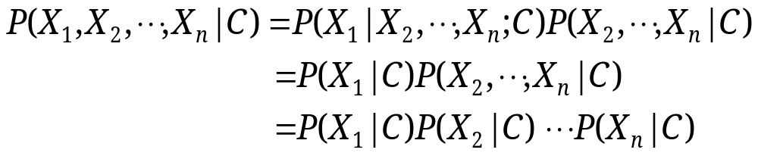
Naïve Bayes
Bayes classification
  Difficulty: learning the joint probability
Naïve Bayes classification
  Making the assumption that all input attributes are independent
  MAP classification rule

Slide 16
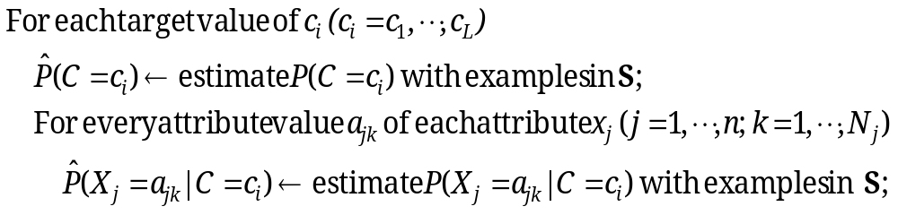


Naïve Bayes
Naïve Bayes Algorithm (for discrete input attributes)
  Learning Phase: Given a training set S,
  Output: conditional probability tables; for elements
  Test Phase: Given an unknown instance ,
  Look up tables to assign the label c* to X’ if

Slide 17

Example
Example: Play Tennis

Slide 18
Example
Learning Phase
Outlook | Play=Yes | Play=No
Sunny | 2/9 | 3/5
Overcast | 4/9 | 0/5
Rain | 3/9 | 2/5
Temperature | Play=Yes | Play=No
Hot | 2/9 | 2/5
Mild | 4/9 | 2/5
Cool | 3/9 | 1/5
Humidity | Play=Yes | Play=No
High | 3/9 | 4/5
Normal | 6/9 | 1/5
Wind | Play=Yes | Play=No
Strong | 3/9 | 3/5
Weak | 6/9 | 2/5
P(Play=Yes) = 9/14
P(Play=No) = 5/14

Slide 19
Example
Test Phase
  Given a new instance,
  x’=(Outlook=Sunny, Temperature=Cool, Humidity=High, Wind=Strong)
  Look up tables
  MAP rule
P(Outlook=Sunny|Play=Yes) = 2/9
P(Temperature=Cool|Play=Yes) = 3/9
P(Huminity=High|Play=Yes) = 3/9
P(Wind=Strong|Play=Yes) = 3/9
P(Play=Yes) = 9/14
P(Outlook=Sunny|Play=No) = 3/5
P(Temperature=Cool|Play==No) = 1/5
P(Huminity=High|Play=No) = 4/5
P(Wind=Strong|Play=No) = 3/5
P(Play=No) = 5/14
P(Yes|x’): [P(Sunny|Yes)P(Cool|Yes)P(High|Yes)P(Strong|Yes)]P(Play=Yes) = 0.0053
P(No|x’): [P(Sunny|No) P(Cool|No)P(High|No)P(Strong|No)]P(Play=No) = 0.0206
Given the fact P(Yes|x’) < P(No|x’), we label x’ to be “No”.

Slide 20
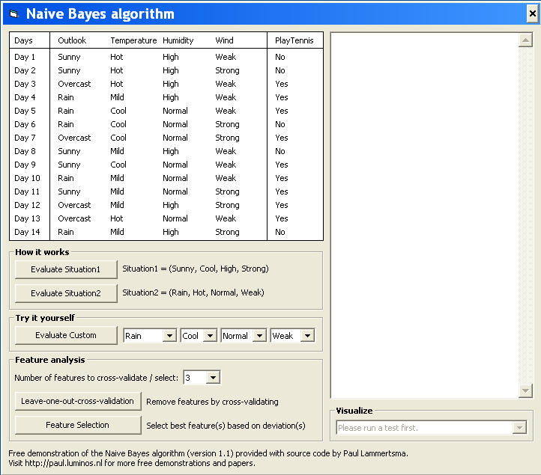
Example
Test Phase
  Given a new instance,
  x’=(Outlook=Sunny, Temperature=Cool, Humidity=High, Wind=Strong)
  Look up tables
  MAP rule
P(Outlook=Sunny|Play=Yes) = 2/9
P(Temperature=Cool|Play=Yes) = 3/9
P(Huminity=High|Play=Yes) = 3/9
P(Wind=Strong|Play=Yes) = 3/9
P(Play=Yes) = 9/14
P(Outlook=Sunny|Play=No) = 3/5
P(Temperature=Cool|Play==No) = 1/5
P(Huminity=High|Play=No) = 4/5
P(Wind=Strong|Play=No) = 3/5
P(Play=No) = 5/14
P(Yes|x’): [P(Sunny|Yes)P(Cool|Yes)P(High|Yes)P(Strong|Yes)]P(Play=Yes) = 0.0053
P(No|x’): [P(Sunny|No) P(Cool|No)P(High|No)P(Strong|No)]P(Play=No) = 0.0206
Given the fact P(Yes|x’) < P(No|x’), we label x’ to be “No”.

Slide 21

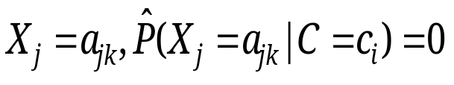
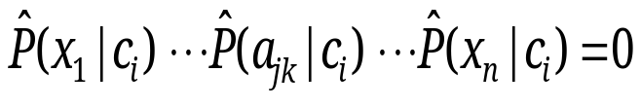
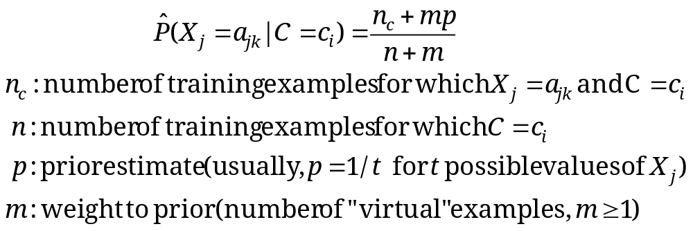
Relevant Issues
Violation of Independence Assumption
  For many real world tasks,
  Nevertheless, naïve Bayes works surprisingly well anyway!
Zero conditional probability Problem
  If no example contains the attribute value
  In this circumstance, during test
  For a remedy, conditional probabilities estimated with

Slide 22
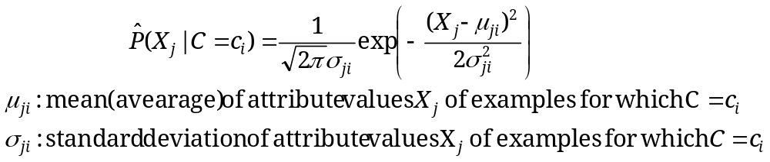




Relevant Issues
Continuous-valued Input Attributes
  Numberless values for an attribute
  Conditional probability modeled with the normal distribution
  Learning Phase:
  Output: normal distributions and
  Test Phase:
    Calculate conditional probabilities with all the normal distributions
    Apply the MAP rule to make a decision

Slide 23
Conclusions
Naïve Bayes based on the independence assumption
  Training is very easy and fast; just requiring considering each attribute in each class separately
  Test is straightforward; just looking up tables or calculating conditional probabilities with normal distributions
A popular generative model
  Performance competitive to most of state-of-the-art classifiers even in presence of violating independence assumption
  Many successful applications, e.g., spam mail filtering
  Apart from classification, naïve Bayes can do more…

